Slide 1

CSE 470/598 Ray Tracing
Ross Maciejewski
rmacieje@asu.edu

Slide 2
Disclaimer
These slides can only be used as study material for the class 470 at ASU
The slides cannot be distributed or used for another purpose

Slide 3
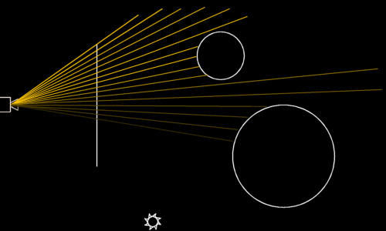
Ray Tracing in C++
Now let’s move from orthographic to any projection

Slide 4
Ray Tracing in C++
vector3 o( 0, 0, -5 );
vector3 dir = vector3( m_SX, m_SY, 0 ) - o;
NORMALIZE( dir );
Ray r( o, dir );
In this code, a ray is started at the origin ('o'), and directed to a location on the screen plane.
The direction is normalized, and the ray is constructed.

Slide 5
Building a Scene
Next, we need a scene to raytrace.
A scene consists of primitives: Geometric objects like spheres and planes.
You could also decide to use triangles, and build all other primitives using those.
In our assignment, we will raytrace sphere, triangles and planes.

Slide 6
Ray Tracing in C++
For each pixel {
Construct ray from camera through pixel
Find first primitive hit by ray
Determine color at intersection point
Draw color
}

Slide 7
Ray Tracing in C++
So our goal is to find the closest primitive to our ray:
// find the nearest intersection
for ( int s = 0; s < m_Scene->GetNrPrimitives(); s++ )
{
Primitive* pr = m_Scene->GetPrimitive( s );
int res;
if (res = pr->Intersect( a_Ray, a_Dist )) {
prim = pr; result = res;
// 0 = miss, 1 = hit, -1 = hit from inside primitive }
}

Slide 8
Determine the Color
Once we know what primitive was hit by the ray, the color for the ray can be calculated.
Simply using the material color of the primitive is too easy; this would result in boring colors without any gradient.
Instead, the sample raytracer calculates a diffuse shading using the two lights.

Slide 9
Determine the Color
// determine color at point of intersection
pi = a_Ray.GetOrigin() + a_Ray.GetDirection() * a_Dist;
// trace lights
for ( int l = 0; l < m_Scene->GetNrPrimitives(); l++ ) { Primitive* p = m_Scene->GetPrimitive( l );
if (p->IsLight()) {
Primitive* light = p;
// calculate diffuse shading
vector3 L = ((Sphere*)light)->GetCentre() - pi; NORMALIZE( L );
vector3 N = prim->GetNormal( pi );
if (prim->GetMaterial()->GetDiffuse() > 0) {
float dot = DOT( N, L );
if (dot > 0) {
float diff = dot * prim->GetMaterial()->GetDiffuse();
// add diffuse component to ray color a_
Acc += diff * prim->GetMaterial()->GetColor() *
light->GetMaterial()->GetColor();
} } } }

Slide 10
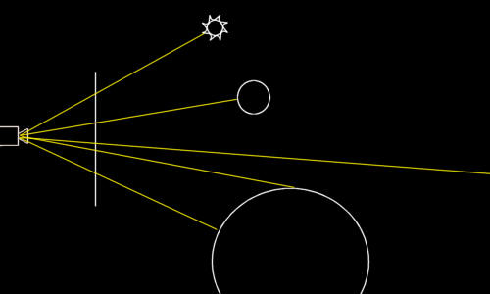
Primary vs Secondary Rays

Slide 11
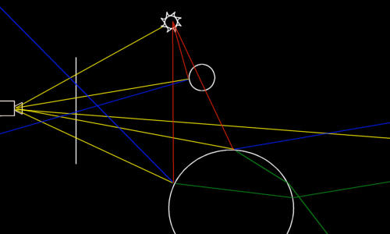
Primary vs. Secondary Rays

Slide 12
Primary vs. Secondary Rays
The blue lines in this picture are reflected rays.
For reflection, they simply bounce off the surface. How to do that exactly will be addressed in a moment.

Slide 13
Primary vs. Secondary Rays
The green lines are refracted rays. These are a bit harder to calculate than reflected rays, but it's quite doable.
It involves refraction indices and a law formulated by Mr. Snell

Slide 14
Primary vs. Secondary Rays
The red lines are rays used to probe a light source.
Basically, when you want to calculate the diffuse lighting, you multiply the dot product by 1 if the light source is visible from the intersection point, or 0 if it is occluded.
Or 0.5 if half of the light source is visible.

Slide 15
Primary vs. Secondary Rays
If you follow one of the yellow rays starting at the camera, you will notice that each ray spawns a whole set of secondary rays:
One reflected ray, one refracted ray and one shadow ray per light source.
After being spawned, each of these rays (except for shadow rays) is treated as a normal ray.
That means that a reflected ray may be reflected and refracted again, and again, and again…
This technique is called 'recursive raytracing'.
Each new ray adds to the color that its ancestor gathers, and so finally each ray contributes to the color of the pixel that the primary ray was originally shot through.
To prevent endless loops and excessive rendering time, there is usually a limit on the depth of the recursion.

Slide 16
Reflections
To reflect a ray of a surface with a known surface normal, the following formula is used:
R = V – 2 * (V·N) * N
(where R is the reflected vector, V is the incoming vector and N is the surface normal)

Slide 17
Reflection
// calculate reflection
float refl = prim->GetMaterial()->GetReflection();
if (refl > 0.0f) {
vector3 N = prim->GetNormal( pi );
vector3 R = a_Ray.GetDirection() - 2.0f *
DOT( a_Ray.GetDirection(), N ) * N;
if (a_Depth < TRACEDEPTH) {
Color rcol( 0, 0, 0 );
float dist;
Raytrace( Ray( pi + R * EPSILON, R ), rcol, a_Depth + 1, a_RIndex, dist );
a_Acc += refl * rcol *
prim->GetMaterial()->GetColor();
}
}

Slide 18
Better Lighting?
Creating 'perfect' lighting is extremely complex, so we will have to revert to an approximation.
While the diffuse shading we used so far is excellent for soft looking objects, it's not so great for shiny materials.
Besides, it doesn't give us any control at all, other than the intensity of the lighting.

Slide 19
Diffuse and Specular
The diffuse shading is ok:
A diffuse material scatters light in all directions, and so its brightest spit is exactly there where the material faces the light source.
Taking the dot product between the normal and a vector to the light gives this result.
Specular shading is a bit different:
Basically, the specular highlight is a diffuse reflection of the light source.
Phong suggested the following lighting model, that indeed takes the reflected vector into account:
intensity = diffuse * (L.N) + specular * (V.R)n

Slide 20
Specular
vector3 V = a_Ray.GetDirection();
vector3 R = L - 2.0f * DOT( L, N ) * N;
float dot = DOT( V, R );
if (dot > 0) {
float spec = powf( dot, 20 ) *
prim->GetMaterial()->GetSpecular() * shade;
// add specular component to ray color
a_Acc += spec * light->GetMaterial()->GetColor(); }

Slide 21
Shadows
The last type of secondary ray is the shadow ray.
These are a bit different than the others:
They do not contribute directly to the color of the ray that spawned them
Instead they are used to determine whether or not a light source can 'see' an intersection point.
The result of this test is used in the diffuse and specular lighting calculations.

Slide 22
Shadows
// handle point light source
float shade = 1.0f;
if (light->GetType() == Primitive::SPHERE) {
vector3 L = ((Sphere*)light)->GetCentre() - pi;
float tdist = LENGTH( L ); L *= (1.0f / tdist);
Ray r = Ray( pi + L * EPSILON, L );
for ( int s = 0; s < m_Scene->GetNrPrimitives(); s++ ) {
Primitive* pr = m_Scene->GetPrimitive( s );
if ((pr != light) && (pr->Intersect( r, tdist ))) {
shade = 0; break; } } }

Slide 23
Shadows
The result of the test is stored in a floating point variable 'shade': 1 for a visible lightsource, and 0 for an occluded light.
Using a float for this might seem odd; however later on we will add area light sources, and those are often only partially visible.
In that case, a 'shade' value between 0 and 1 would be used.
By the way, the above code does not always find the nearest intersection point of the shadow ray with the primitives in the scene.
This is not necessary: any intersection with a primitive that is closer than the light source will do.
This is quite an important optimization, as we can break the intersection loop as soon as an intersection is found.

Slide 24
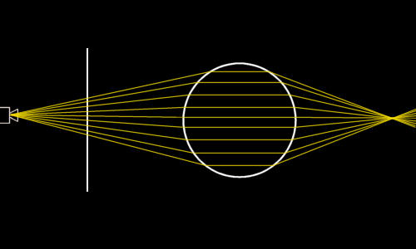
Refractions
Notice how the rays bend at the surface of the primitve, and how they pass through one point behind the primitive.
Objects behind this point will appear flipped and mirrored because of this.
How the rays are bent at the surface of the primitive depends on the refraction index of two materials:
The material that the ray is in before it enters the primitive, and the material that the primitive is made of.
Some examples: Air and vaccuum have a refraction index of about 1.0;
water at 20 degrees Celcius has a refraction index of 1.33.

Slide 25
Coding Refraction
Construct the refracted ray, trace it (recursively of course) and adds the resulting color to the ray that spawned the refracted ray.
The normal is multiplied by the value in the variable 'result'.
This is a value that is filled by the intersection code for each primitive.
It can either be 1 or 0, denoting a hit or a miss.
There's a third option though: -1 means hit, but from within the primitive.
This means that the origin of the ray that hit the primitive was inside the primitive itself.
When a ray hits a primitive from the outside, basically it doesn't hit the primitive, but the matter around it. And therefore, the normal is reversed.

Slide 26
Refractions
// calculate refraction
float refr = prim->GetMaterial()->GetRefraction();
if ((refr > 0) && (a_Depth < TRACEDEPTH)) {
float rindex = prim->GetMaterial()->GetRefrIndex(); float n = a_RIndex / rindex;
vector3 N = prim->GetNormal( pi ) * (float)result;
float cosI = -DOT( N, a_Ray.GetDirection() );
float cosT2 = 1.0f - n * n * (1.0f - cosI * cosI);
if (cosT2 > 0.0f) {
vector3 T = (n * a_Ray.GetDirection()) +
(n * cosI - sqrtf( cosT2 )) * N;
Color rcol( 0, 0, 0 );
float dist; Raytrace( Ray( pi + T * EPSILON, T ), rcol, a_Depth + 1, rindex, dist ); a_Acc += rcol;
} }

Slide 27
Beer’s Law
Imagine a pool with a colored substance (water mixed with blue ink, for example).
At the shallow end of the pool the water is just 10 cm deep; at the other end it's over a meter.
If you look from above to the bottom, it's rather obvious that at the shallow end, the bottom will be far less affected by the color of the ink than at the deep end.
The effect of the colored medium is stronger over longer distances. This effect is called Beer's law. So, let's obey it.

Slide 28
Beer’s Law
Beer's law can be expressed in the following formula:
light_out = light_in * e^{–(e * c * d)}
This formula is primarily intended to calculate the light absorbance of a substance that is dissolved in water.
'e ' is some constant that specifies the absorbance of the solvent at hand (to be precise, the molar absorbtivity with units of L mol-1 cm-1);
'c' is the amount of this stuff, in mol L-1.
'd' is the path length for the ray.
If you just want the light to fall-off in a material that is not 100% translucent
light_out = light_in * e^{–(d * C)}

Slide 29
Coding Beer’s Law
Color absorbance = prim->GetMaterial()->GetColor() * 0.15f * -dist;
Color transparency = Color( expf( absorbance.r ),
expf( absorbance.g ),
expf( absorbance.b ) );
a_Acc += rcol * transparency;

